Slide 1
Neural Architectures:
Transformers
Introduction to Deep Learning: Class 5.7

Slide 2
Agenda
Recap transformer architecture
Decoding techniques
KV-caching

Slide 3
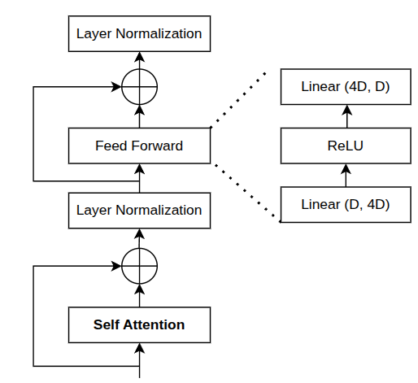
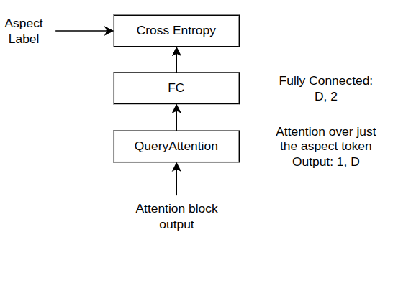
Quick Recap: Transformer Architecture
Attention Block
Outputs contextualized embeddings
Feed Forward: Mixes info across embedding (channel) dimension with non-linearities
Skip Connection: Stable optimization, don’t destroy previous representation
LayerNorm: Keeps activations well-scaled, learning stable
1, T, D
e1+p1 | e2+p2 | e3+p3 | e4+p4 | e5+p5 | e6+p6 | e7+p7 | e8+p8 | e_pad+p9 | e_pad+p10 | e_pad+p11 | e_pad+p12
Trainable token + position embeddings
1 | 1 | 1 | 1 | 1 | 1 | 1 | 1 | 0 | 0 | 0 | 0
Attention mask
t1 | t2 | t3 | t4 | t5 | t6 | t7 | t8 | pad | pad | pad | pad
Tokenization
Input Sentence

Slide 4
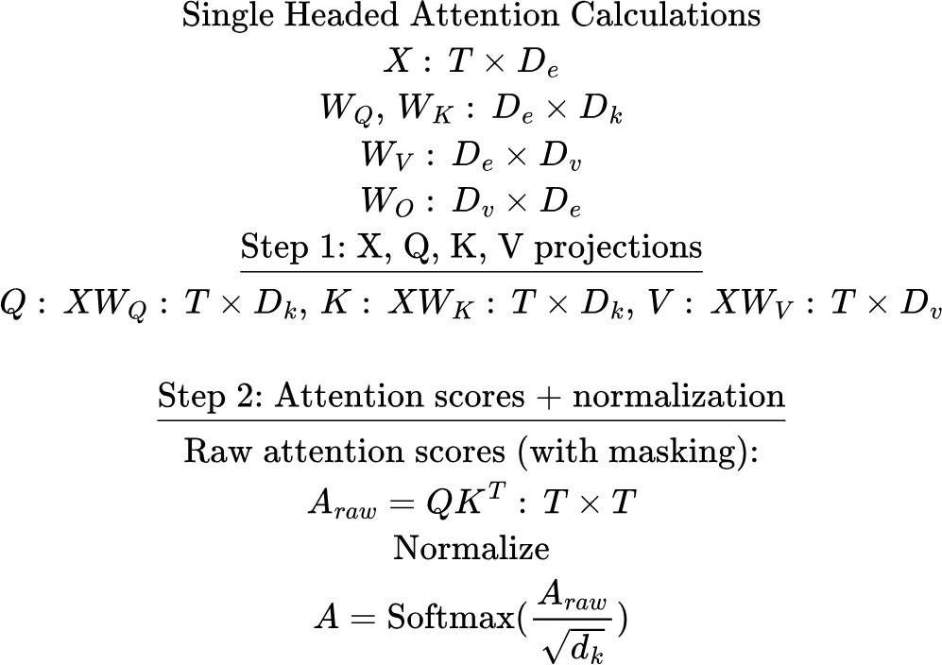
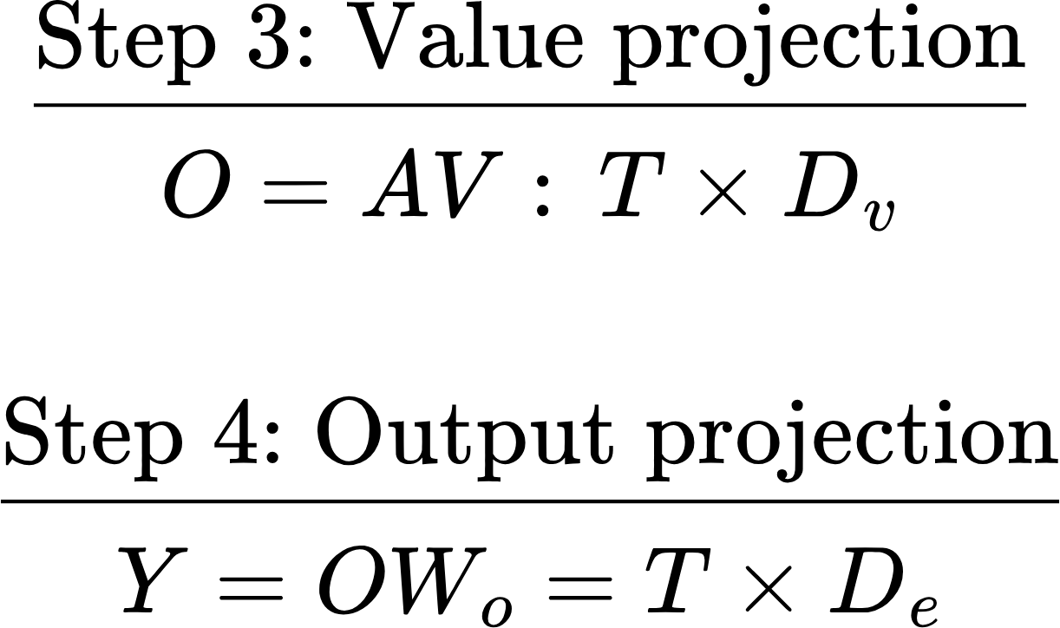
Attention Summary

Slide 5
Decoder-only (Generative) models
Key idea: The model needs to learn to assign higher probabilities to more plausible input sequences
P(model, needs, to, learn) > P(needs, learns, model, to)
Like BERT, the training signal is inherent in the token sequence. How do we utilize this in a generative context?
To do this, each token must only see the tokens before it.. This is implemented using a causal attention mask

Slide 6
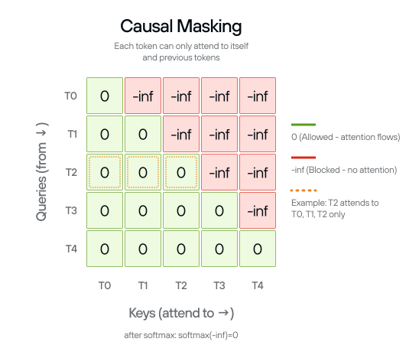
Causal Attention Mask
T0 only sees the keys corresponding to T0
T1 only sees the keys corresponding to T0, T1
T2 only sees the keys corresponding to T0, T1, T2

Slide 7
Generative Model: Training
X-entropy loss
Target tokens
Hello, how, are, you, <EOS>
Predicting end of a sentence is very important!
<BOS>, Hello, how, are, you
Target logits
Input
Target
Transformer Block
Causal Attention Mask
<BOS>, Hello, how, are, you
Hello, how, are, you, <EOS>
<BOS>, Hello, how, are, you, <EOS>
Input tokens
Tokenization, embedding lookup, positional embeddings remain unchanged
Hello, how, are, you

Slide 8
Generative Model: Training
We are computing in parallel
P(Hello|Bos)
P(How|Bos, Hello)
P(Are|Bos, Hello, How)
P(You|Bos, Hello, How, Are)
P(EOS|Bos, Hello, How, Are, You)
And minimizing the negative of the sum of these probabilities
Training Signal:
weak / diffuse for short ambiguous prefixes
stronger / sharper for longer informative prefixes

Slide 9
Generative Model: Inference
Key idea: Autoregressively generate one token after the other
fox
jumps
over
Decoding: Sample a token
Decoding
Decoding
Probability distribution over tokens: p(V)
p(V)
p(V)
Transformer
Transformer
Transformer
<BOS>, The, quick, brown
<BOS>, The, quick, brown, fox
<BOS>, The, quick, brown, fox, jumps

Slide 10
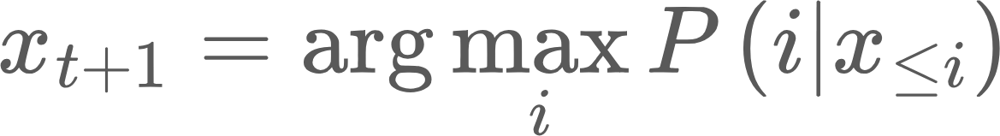
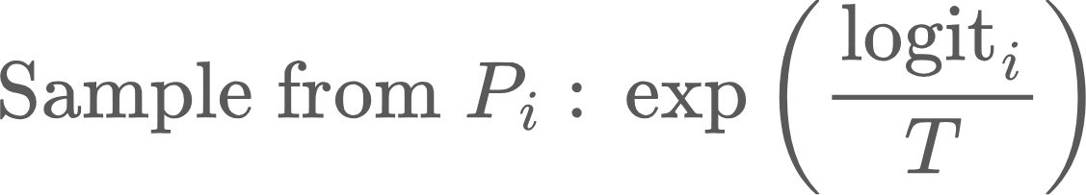
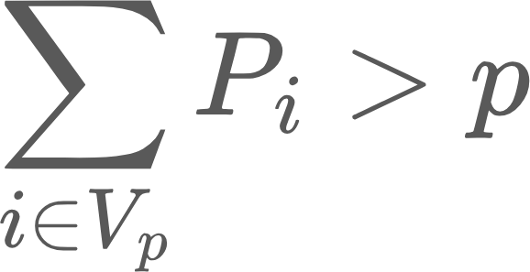
Decoding techniques
Greedy decoding: Pick most probably token
Deterministic
Temperature sampling
Allows some degree of randomness
Adjusted by T. T> 1: more randomness and vice versa
Top-k sampling
Keep the top K tokens by probability, renormalize and sample
Only keep the most plausible tokens
Top-P nucleus sampling
Keep smallest set of tokens whose cumulative probability > p
Intuition: keep enough tokens to cover most of the probability mass
Repetition penalty:
Beam Search

Slide 11
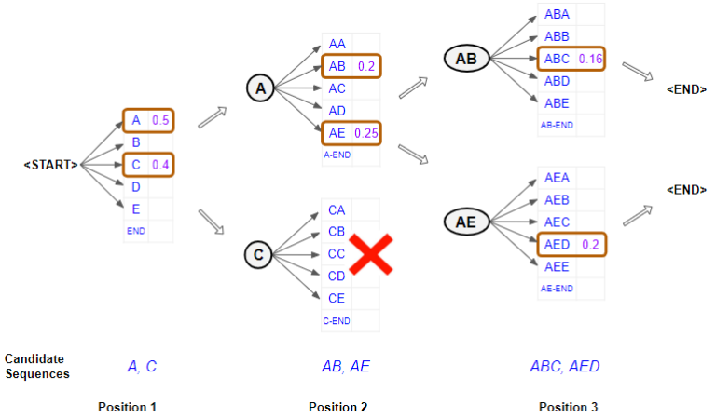
Beam Search
Problem with Greedy decoding techniques is that once you pick a suboptimal token, you are stuck with it, as all future tokens are conditioned on it.
Beam search:
Keep B tokens at each generation step
Run B parallel generations and sample B best tokens from BV possibilities
Track which beam each token came from
Stop after predefined number of steps, or after most (say k) beams produce EOS
Trace back to pick the most likely completion, by summing log probs
Pros: Can lead to more diverse outcomes
Cons: Computationally much more expensive
Less commonly used now

Slide 12
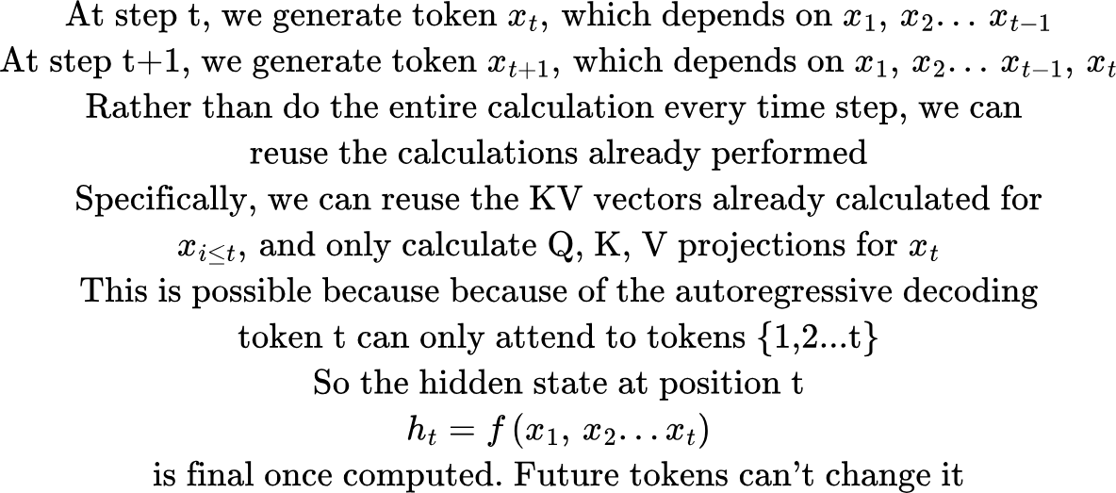
KV Caching

Slide 13
Issues with kv-caching
Size of the cache: [seq len, num layers, num heads, head dimension]
As decoding proceeds, sequence length grows token by token, KV cache memory grows linearly, and is needed for the entire request
Now consider a real system
Many requests
Each with different prefix lengths
Each with different number of generated tokens.. We don’t know apriory when generation would end

Slide 14
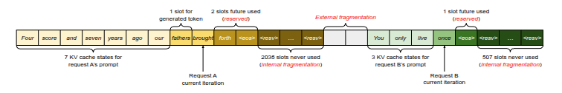
Fragmentation problem
You allocate one big block per sequence
Request A: 2048 tokens
Request B: 512 tokens
Request C: 4096 tokens..
If I reserve a block of 4K tokens, that wastes memory for A and B, but not enough for C. I’ll have to reallocate another bigger block, and copy the KV cache in the middle of decode!

Slide 15
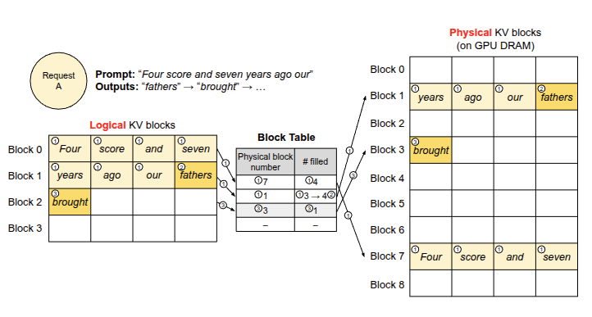
Paged attention
Key idea: Instead of each sequence owning its own contiguous memory block, it maintains a logical view of several small physical blocks

Slide 16
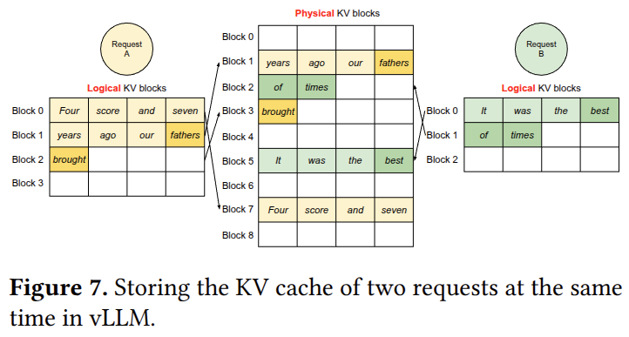
Paged attention
No need to guess seq len. Just allocate pages on-demand. When completion finishes, release pages back to the pool

Slide 17
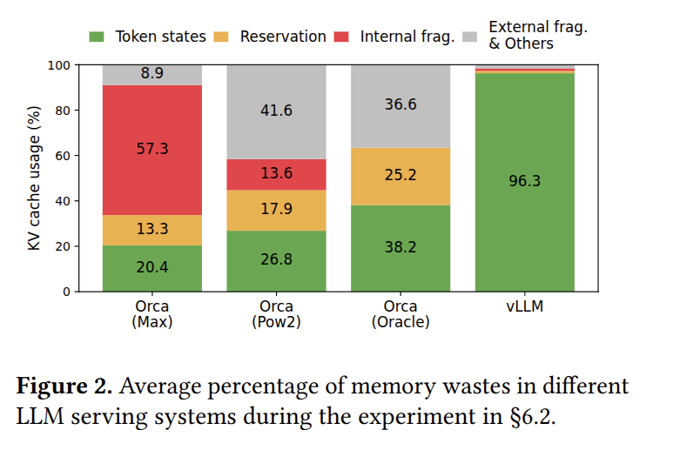
Paged Attention: Memory Savings

Slide 18
vLLM and FlashAttention
User / Client
OpenAI-compatible API, Python API, batch/offline inference
vLLM serving/runtime layer
request intake, streaming outputs, cancellation, metrics
vLLM engine core
scheduler, continuous batching, KV-cache manager,prefix cache, block table, model execution coordination
GPU worker / model executor
runs transformer layers, handles TP/PP/DP/EP communication
Per-layer kernels
attention kernels, GEMM kernels, MoE kernels, norm kernels, quantization kernels, sampling kernels

Slide 19
vLLM and FlashAttention
Sampling kernel
MLP: matmul kernel
Output Projection: matmul kernel
Attention: FlashAttention kernel
QKV Projection: matmul kernel
RMS/LayerNorm kernel
For each transformer layer
Input token embedding lookup, position embeddings

Slide 20
Arithmetic Intensity
Arithmetic Intensity (AI): How much computation we do per unit of data moved
AI = FLOPs/Bytes moved
High AI: Lot of math per unit data moved, compute bound
Low AI: Little math per unit data moved, memory bandwidth-bound
Examples
y = x + 1: just one calculation for 1 R/W
Matrix Multiplication: High AI (each row/col is used to calculate several elements of the output matrix)

Slide 21
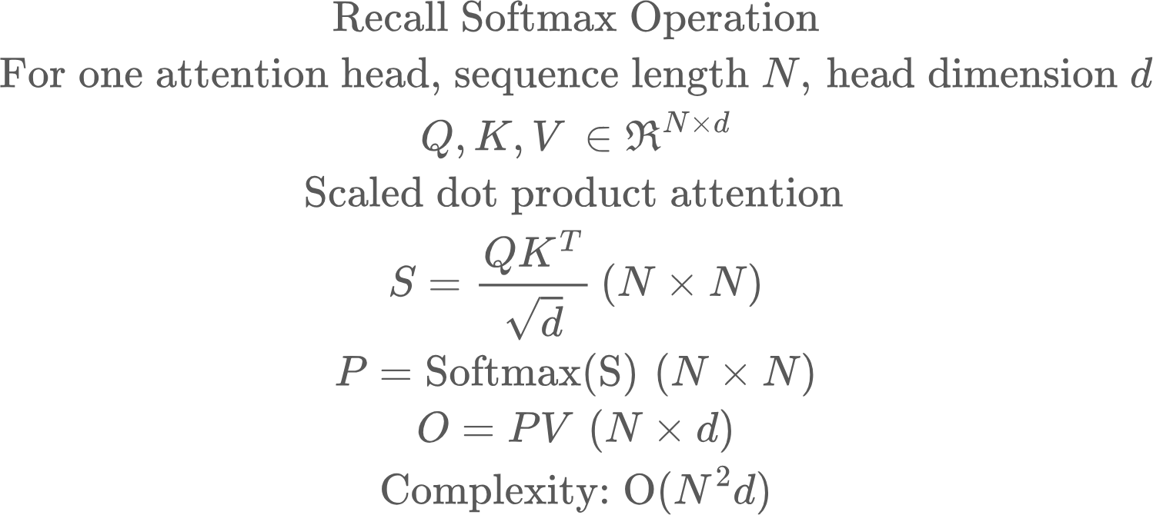
FlashAttention

Slide 22
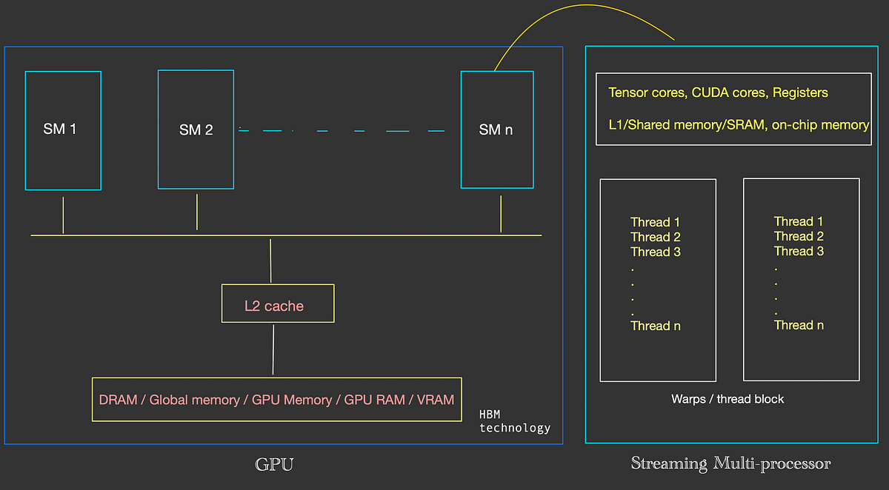
GPU Architecture
Streaming Microprocessors (SM): Where calculations happen
SRAM: Local data storage
DRAM: Global memory, but data must be transferred to SRAM for compute

Slide 23
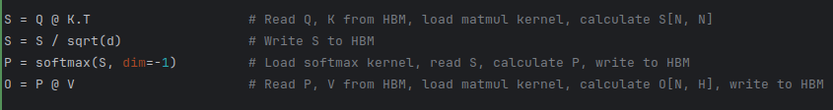
Attention: Naive Implementation
Problem 1: The intermediate matrices can be huge.
Say N = 8192, then each attention matrix (fp16) = 8192*8192*2 bytes ~134 MB
This much data must be written back and forth for every attention head for every layer for every sequence in the batch

Slide 24
Attention: Naive Implementation
Problem 2: Multiple kernel launches, which also precludes sharing data, as one kernel can’t access previous kernel’s SRAM

Slide 25
Solution: Tiling, Streaming and Kernel Fusion
Flash Attention does two big things:
Do not make the GPU remember the whole attention matrix. Stream through it in tiles and accumulate the final answer.
Fuse the various calculations in attention into a single kernel. This is called kernel fusion

Slide 26
Tiled multiplication
Recall what we are doing in the attention operation
For a query vector, we calculate the dot product against all the key vectors to get raw attention scores
We normalize the scores
We calculate a weighted average of the value vectors with the attention scores as the weights
Let’s say we didn’t have the normalization

Slide 27
Tiled multiplication
Read first two columns of the key matrix
Read first two columns of the value matrix
Query vector
Divide K, V matrices into blocks
Given a query vector,
Initialize output vector
For every K, V block:
Calculate dot product between query and K block
Use the coefficients to calculate weighted average of V block
Accumulate weighted average into the output vector
Write output vector back to HBM
Advantage: I’m reading less data each time (B*D for each block), the full matrix multiplcation vector doesn’t need to be materialized.

Slide 28
Tiled multiplication
The idea can easily be extended to multiple query rows
Read first three rows of the query matrix
Read first two columns of the key matrix
Read first two columns of the value matrix
Divide K, V matrices into blocks. The block size for K, V must be equal, query block size can be different
Given a query matrix,
Initialize output matrix
For every K, V block:
Calculate dot product between query and K block
Use the coefficients to calculate weighted average of V block
Accumulate weighted average into the output matrix
Write output vector back to HBM
Query matrix

Slide 29
Tiled multiplication
keys
values
Iteration 2
Read first three rows of the query matrix
Iteration 3
Query matrix

Slide 30
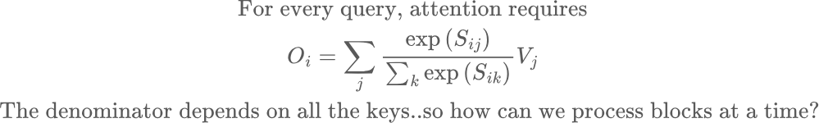
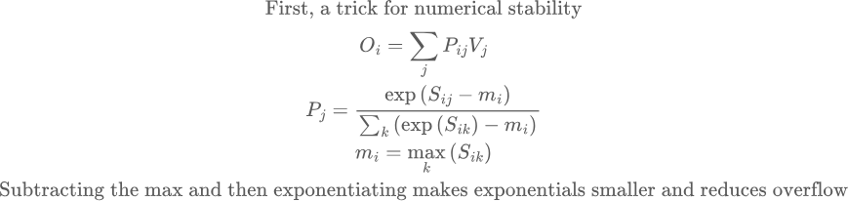
Problem: Softmax

Slide 31
Problem: Softmax
To compute the denominator and the sum, we need all the keys!

Slide 32
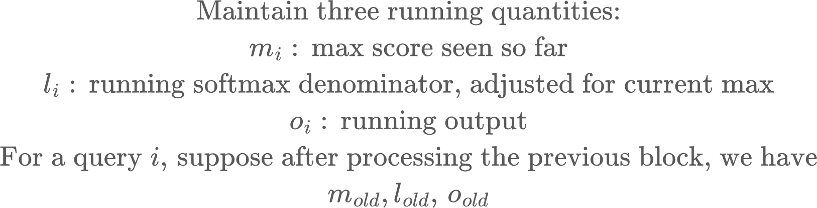
The solution: Online Softmax
Core idea: Maintain running counters that are updated as K, V are streamed in, such that the final output is the same

Slide 33
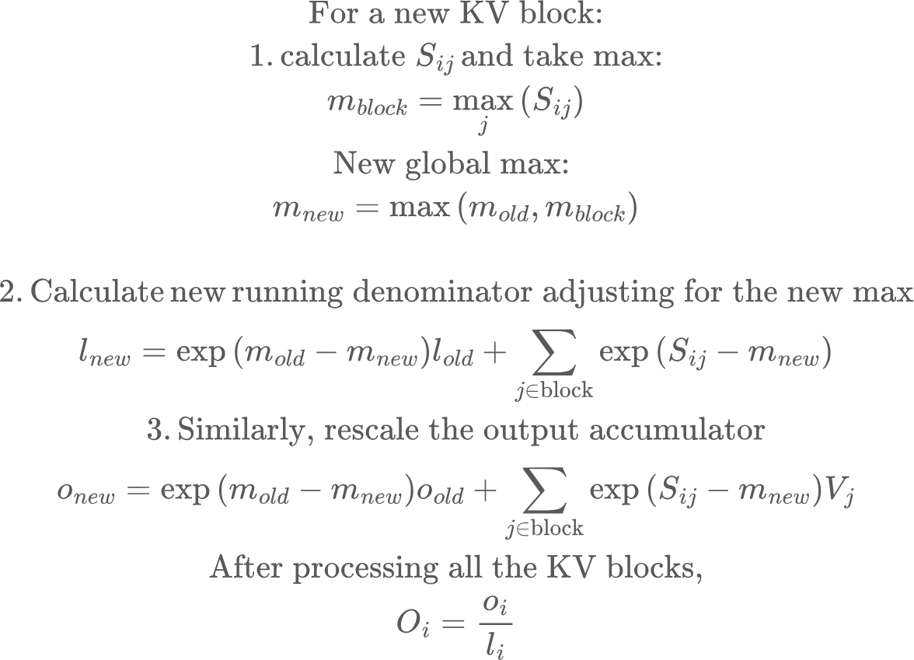
The solution: Online Softmax
Note: the running averages can stay in SRAM, as KV blocks are streamed in to the same FlashAttention kernel. No new kernel launches

Slide 34
FlashAttention: Summary
Traditional attention is slow because:
Materializes N^2 intermediates
Repeatedly moves them through HBM between separate kernels. HBM may be large enough to store them, but the bandwidth cost of writing and rereading them is huge.
FlashAttention fuses the attention computation and uses tiled online softmax so each small score tile is created on-chip, consumed immediately, and never written to HBM.

Slide 35
Training vs Inference
Training requires forward and backward pass, and avoiding the N,N attention matrix was a key enabler in making long-context training possible. Adapting the backprop math in the backward pass to FlashAttention is tricky!
For Inference prefill, we process the entire prompt at once, and FlashAttention is critical to lower TTFT
For Inference decode, we are calculating attention score of the current token wrt previous KV cache.. So the attention matrix is only 1,N and FlashAttention is less important.
Decode is dominated by reading KV cache from memory, so paged attention, kv cache layout become more important..

